Slide 1





Creative Problem Solving and Innovation - Presentation
SkillSwap-Campus
Learn.Teach.Repeat.
Trade skills, grow together
PRESENTED BY:
ANSHUL PRAKASH
K.DHEERAJ SAI SUHAS REDDY
VEDA
SANJANA
ABDUL AHAD
FAIZAAN NASIR
ARNAV KESHAV SINHA

Slide 2



SkillSwap - Campus
About The Idea
Everyone knows something.
Everyone wants to learn something.
But why is a Platform like SkillSwap needed??
A student may want to learn DSA, UI/UX, Public speaking, Python, video editing, guitar, etc., while someone nearby already knows it.
The problem is not lack of knowledge ,its lack of connection.

Slide 3
What stops the students from learning from people around them??
The major issues concerning this problem are:
*Invisible connections- Students often do not know who around them can teach the skill they want.
*Platform Gap- Existing learning platforms are course-based, not person-based.
*Social silos- Students stay inside familiar friend circles, so useful skills remian hidden.
*Cost Barrier- Learning a new skill may mean paying for courses or using external platforms.

Slide 4



SkillSwap - Campus
What is SkillSwap
A campus-only platform built around complementary skills and shared curiosity.
LEARN → TEACH → CONNECT
The value comes from exchange: both sides bring something and both sides gain something.

Slide 5

SkillSwap - Campus
What makes SkillSwap different??
Keeps the concept focused on peer-to-peer skill exchange.
The Core Idea:
• Students list what they can teach.
• Students list what they want to learn.
• The system finds complementary people.
• Both sides choose whether to connect.
• The connection is designed to lead to a learning session.
Why does it fit a campus?
• The users already share an environment.
• Many skills are informal and peer-taught.
• Students can learn from people closer to their context.
• One person can be both teacher and learner.
• Knowledge can move across existing social circles.

Slide 6

SkillSwap - Campus
How does it work?
From - I want to learn to I found someone
Create
Add skills you want to teach and skills you want to learn
Discover
See students from same campus with relevant skills
Interest
Show interest when the profile looks useful to start a conversation
Match
Mutual interest creates a learning connection
Exchange
Chat, schedule, teach, learn and share resources

Slide 7
SkillSwap - Campus
What a student actually does?
This reduces friction between interest and action
SkillSwap surfaces students who can teach Python and UI/UX
They move into an actual learning session
Person A:
I want to teach Python + React.
Person B:
I want to learn UI/UX
When both show interest → match

Slide 8
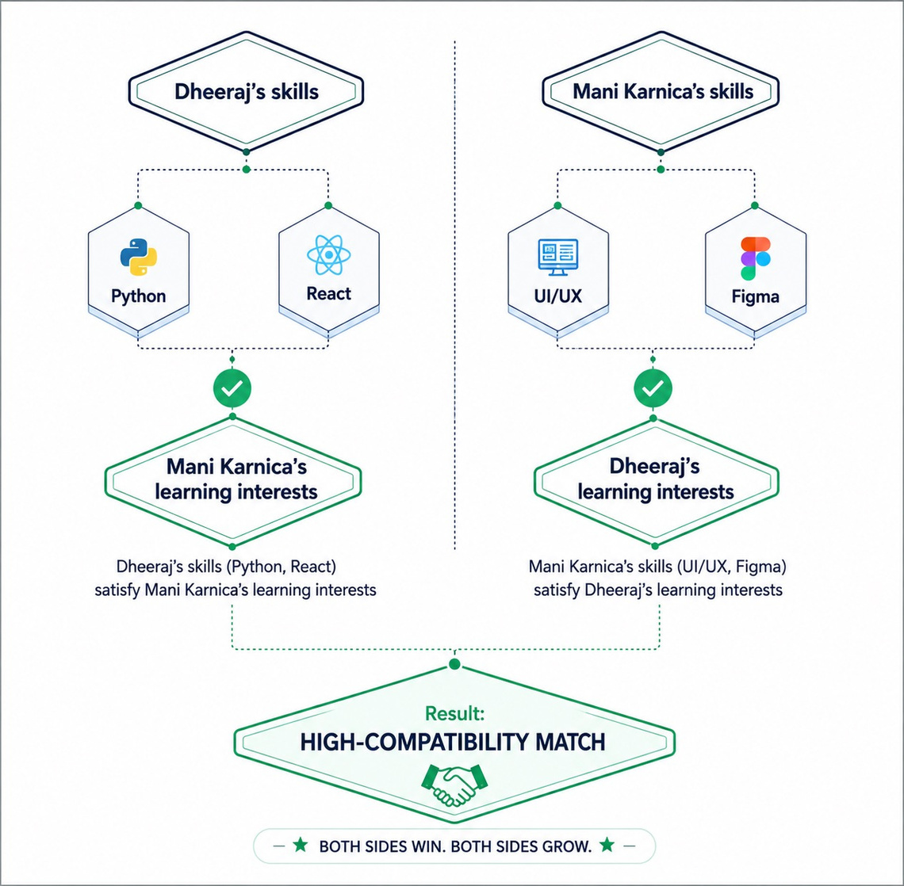
SkillSwap - Campus
Smart matching:
Dheeraj
CAN TEACH
Python • React
WANTS TO LEARN
UI/UX
Mani karnica
CAN TEACH
UI/UX • Figma
WANTS TO LEARN
Python
Why this match works?
Dheeraj teaches Python → Mani karnica learns Python
Mani karnica teaches UI/UX → Dheeraj learns UI/UX

Slide 9
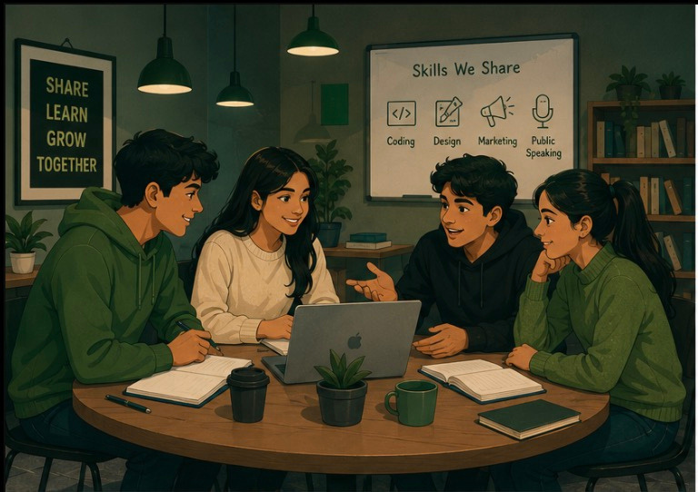

SkillSwap - Campus
Sometimes the best teacher isn't online — they're sitting a few seats away
When students teach students, the campus becomes more than a place to study.

Slide 10
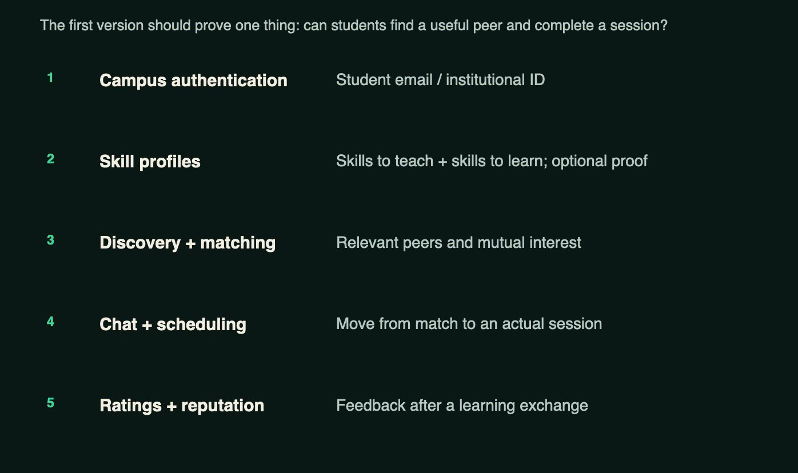

MVP : What we build first :

Slide 11
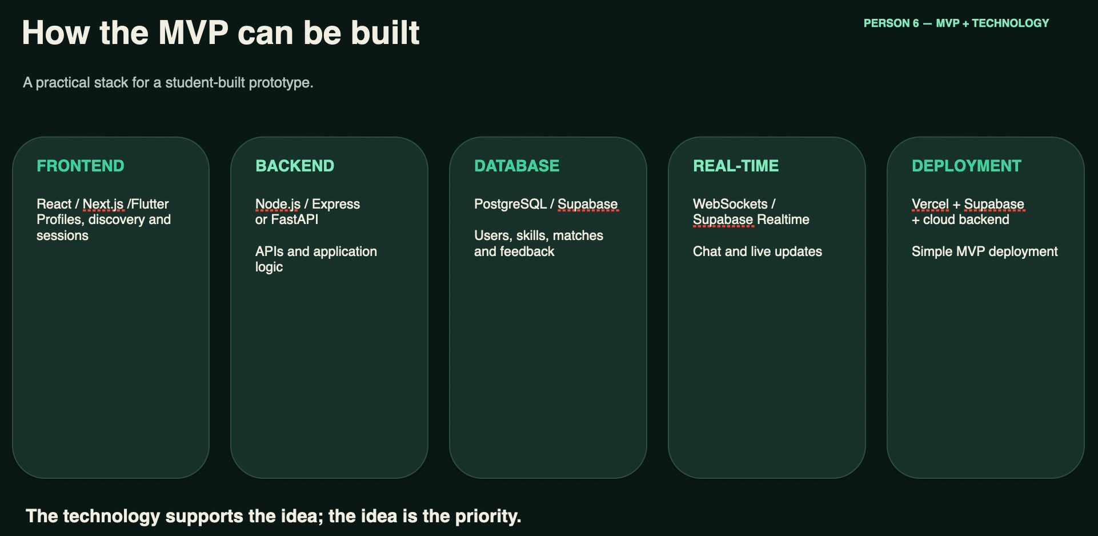

Slide 12
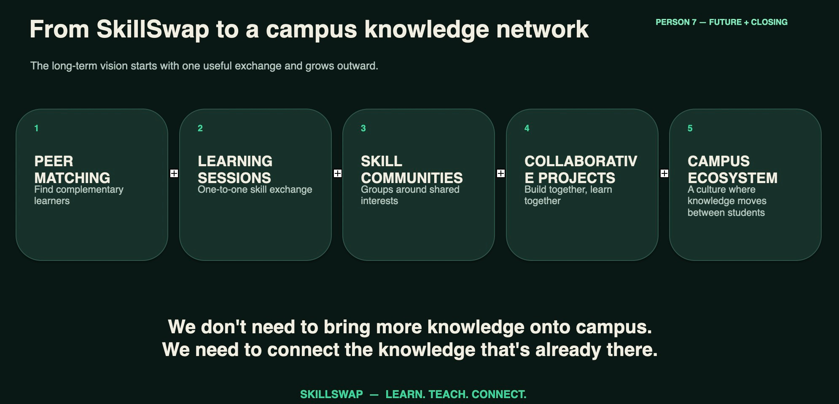
Advantages :

Slide 13

SkillSwap - Campus
Thank
you!

